Slide 1
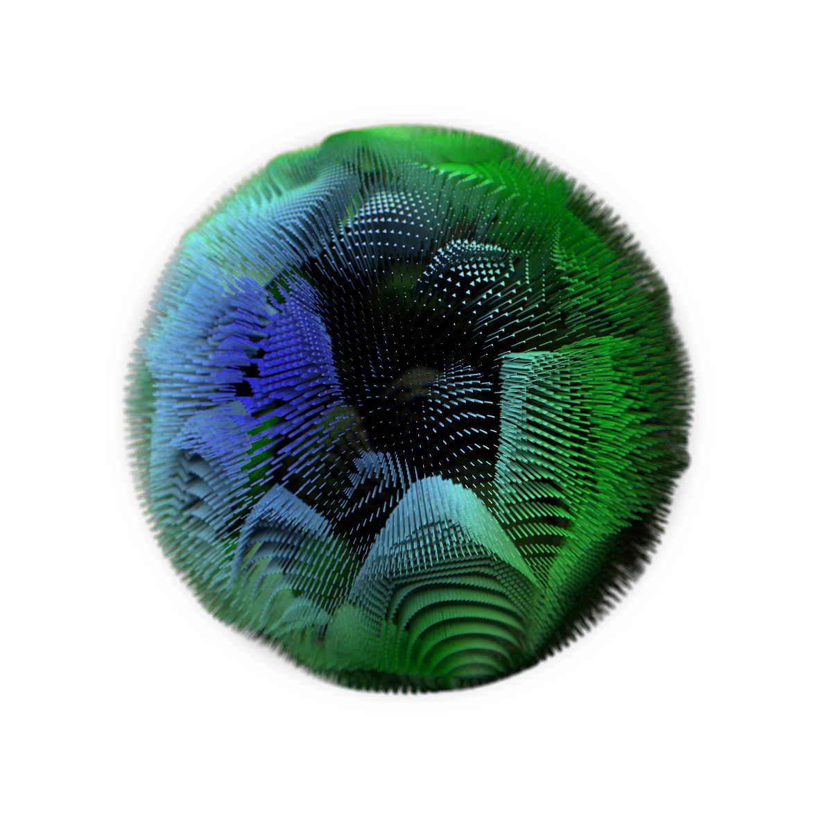
Dimensionality
Reduction
Gert De Geyter – Machine learning guild bootcamp - March 2020

Slide 2
Dimensionality reduction
Feature selection Finding the optimal subset of relevant features to solve your problem
Feature Projection or Dimensionality Reduction
Finding the optimal representation of your features by reducing the number of dimensions
It’s a necessary step as this allows you to create potential more relevant features as well as reducing the data in general. This again leads to better performance of model and runtime. It is also often used as a step to help visualize the data.

Slide 3
Dimensionality reduction
Firm | Monday | Tuesday | Wednesday | Thursday | Friday | Saturday | Sunday
Client1 | 10 | 10 | 10 | 10 | 10 | 0 | 0
Client2 | 5 | 5 | 5 | 5 | 5 | 0 | 0
Client3 | 8 | 8 | 8 | 8 | 8 | 8 | 8
Client4 | 0 | 0 | 0 | 0 | 0 | 4 | 4
Suppose we have this (extreme) case where a catering services delivers sandwiches to different firms. They are open every day and this is the data they have for a week.
We can see that the data clearly contains two separate blocks, weekdays and weekends. So the question in this case is, how can we summarize the same information in a shorter way without the loss (of a lot) of information?
Firm | Weekday | Weekend
Client1 | 10 | 0
Client2 | 5 | 0
Client3 | 8 | 8
Client5 | 0 | 4
If we make two new columns, weekday and weekend, we can represent the data given above in a more efficient way. Not only is it a smaller data set, we have effectively reduced this problem from 7 dimension to 2 without sacrificing information.

Slide 4
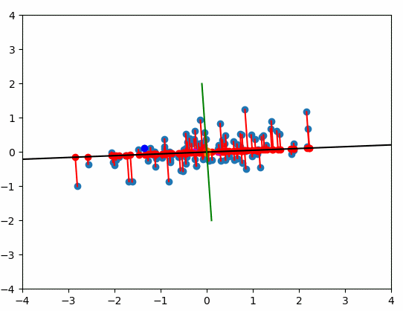
Principal Component Analysis (PCA)
Principal Component Analysis is the most used dimensionality reduction algorithm. It is essentially a rotation of the coordinate system so that the maximum variance is kept.
By looking for the direction in which we have the largest separation we can describe all our data in that dimension with a minimal loss of information. In case of a 2D dataset, the first principal component is the component with the highest variance.
The question now becomes, how do we find that direction in our dataset.
Of course we can extend this to any number of dimensions to be reduced to whatever number we want (more on this later).

Slide 5


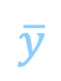
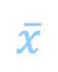
Principal Component Analysis (PCA)
But how to find these directions?
Y
PC1
Calculate the mean $\overline{x}$ and $\overline{y}$ for each dimension
PC2
Determine the covariance matrix: $C=Cov\left(X, Y\right)= \frac{1}{n −1}\sum_{i=1}^{n}{\left(x_{i} − \overline{x}\right)\left(y_{i} − \overline{y}\right)}$
$$\overline{y}$$
Determine the eigenvalues and eigenvectors
$$C \overline{v}= λ\overline{v}$$
$$(C − λ)\overline{v}=0$$
Or if $\overline{v}≠0$
$$Det(C − λ) =0$$
Which give us the eigenvalues and after substitution the corresponding eigenvectors
$$\overline{x}$$
X
Repeatedly multiplying by the covariance matrix moves your coordinate system towards the highest variance direction. So we know the highest variance is found for vectors that don’t change when multiplied by the covariance matrix.
Eigenvector: Direction of maximum variance
Eigenvalue: The magnitude of the variance
Higher eigenvalue means higher variance
4. Change coordinate system to eigenbasis

Slide 6
Principal Component Analysis (PCA)
Additional remarks
Determine cut-off
There are multiple ways to determine the “cut-off” of what is a PC that is useful, and which one is not. A commonly used and easy method is to determine a cut-off in explained variance. Just divide all eigenvalues by the total sum and rank them. You than determine a cut-off to a percentage of covered variance f.e. 95% or 99%.
Normalize data
The original data set can contain a wide variety of ranges within each dimension. For example temperature vs. distance measures. As a result it is usually best to rescale and normalize your data so your data points are centered and can more easily compared in spread. in a lot of PCA implementations, this happens as a default step but it’s often best to check.
Visalizualize data
One of the most used applications for PCA is finding the optimal way to visualize the data into a more reasonable amount of dimensions (usually two or three). For example finding the optimal separation between a set of higher dimensional clusters.
Y
X

Slide 7
Limitations and alternative algorithms
Y
Limitations of PCA
Although PCA is a commonly used method, it is essentially a linear transformation meaning there are some limitations to what relations in your data it can successfully capture. See two examples. In addition there are different types of datasets which could contain a lot of missing data or categorical data.
Alternative algorithms
Other algorithms like kernel PCA, t-SNE or autoencoders can capture non-linear and more complex relations within your dataset. However, there might be a trade-off between performance and explainability or transparency. (feel free to explore them on your own!)
X
Y
X

